Slide 1


AI: An Intelligent Healthcare Assistant

Slide 2
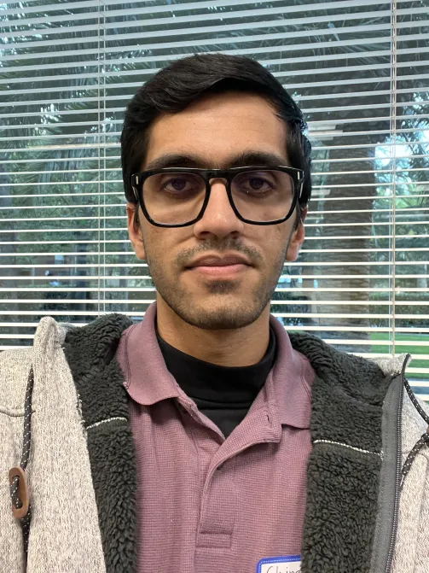





Shahil Dhotre
Chirag Dhamange
Shubham Narkhede
Rahul Phadtare
Anupama Aphale
Savani Shrotri

Slide 3

Introduction
Lung Cancer Symptom Detection Chatbot
Cancer patients often face difficulties in accessing reliable and personalized information during their treatment.
CancerCare AI is an innovative chatbot designed to provide 24/7 support, offering accurate, empathetic responses to patient queries of the symptoms they have high/low changes of lung cancer
This presentation will showcase how our solution aims to improve patient experience and ease the burden on healthcare providers.

Slide 4
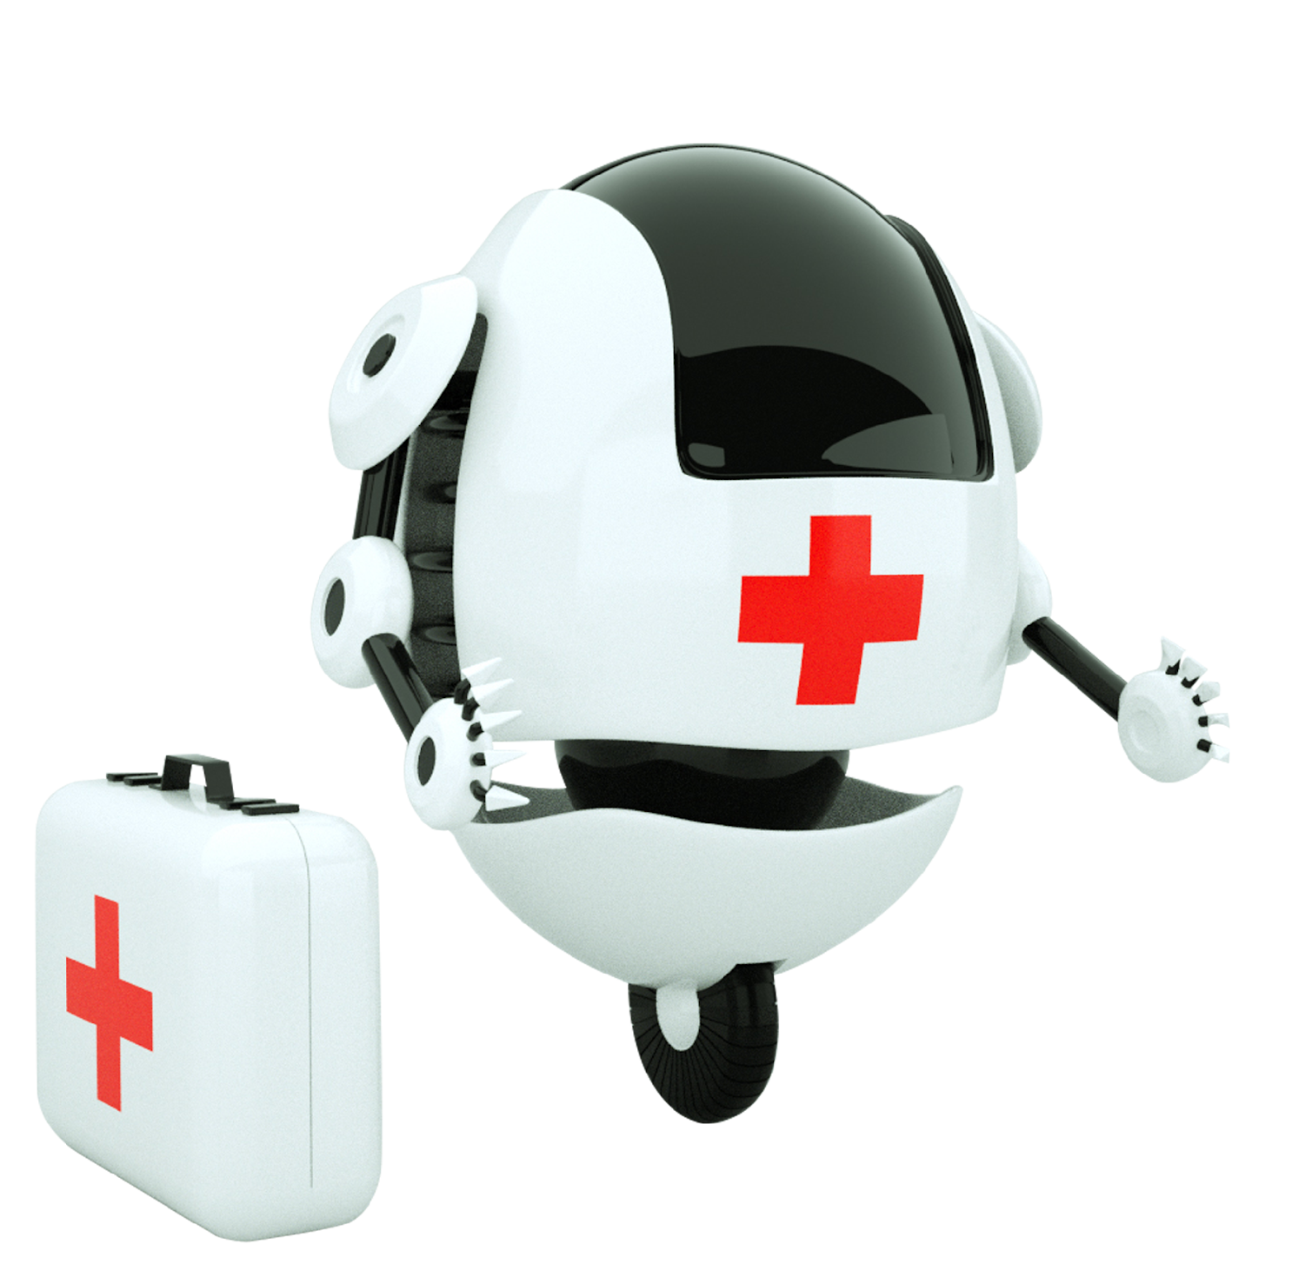
Business Impact
Healthcare Chatbot for analysing patients symptoms to possible diseases.
Scope of this Hackathon: User enters symptoms and chatbot responds with the low/high probability of the person having disease(in this case lung cancer)
Improved Early Detection and Diagnosis
Improved Patient Access to Care
Cost-Effective Healthcare for Patients/Cost Reduction for Healthcare Providers
Enhanced Patient Engagement and Satisfaction
Users : Any person extendable to healthcare professionals, patients and caregivers.

Slide 5


Solution Overview
A conversational AI chatbot tailored specifically for cancer patients.
Provides reliable, context-aware answers to cancer-related questions.
Available 24/7, offering consistent and empathetic support throughout the patient journey.

Slide 6

Technology Stack
Cloud Platform: Oracle Cloud (Hosting and Infrastructure)
Frontend: Streamlit (User Interface)
Backend: FastAPI (API Services)
AI Model: Retrieval-Augmented Generation (RAG) fine-tuned on cancer-specific data
Nugen API for Document and Query Embeddings(nugen-flash-embed)

Slide 7
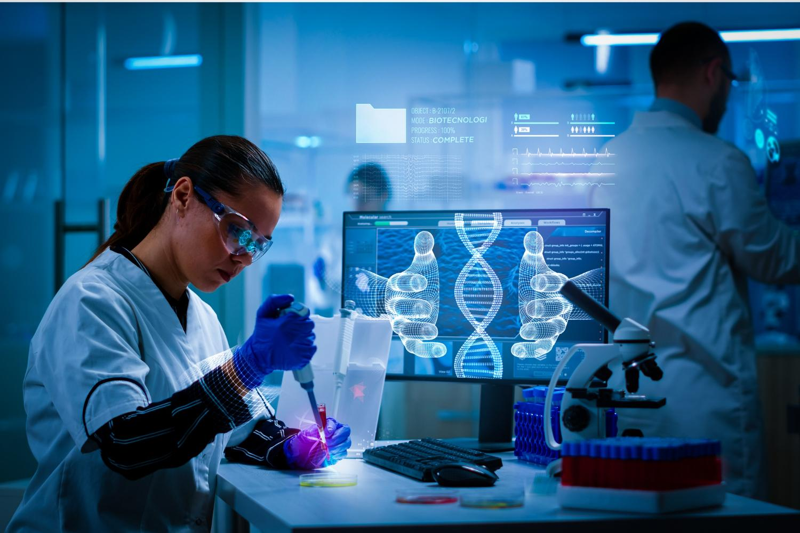
Key Features
Cancer-Specific Knowledge Base: In-depth, accurate answers to cancer-related queries.
24/7 Availability: Provides round-the-clock support for patients and caregivers.
LLM and RAG: : Handles complex medical terminology and patient questions.
User-Friendly Interface: Intuitive design focused on ease of use and patient comfort.

Slide 8
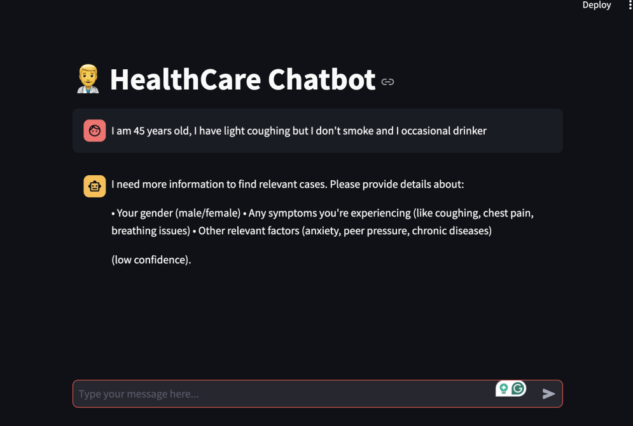

Slide 9
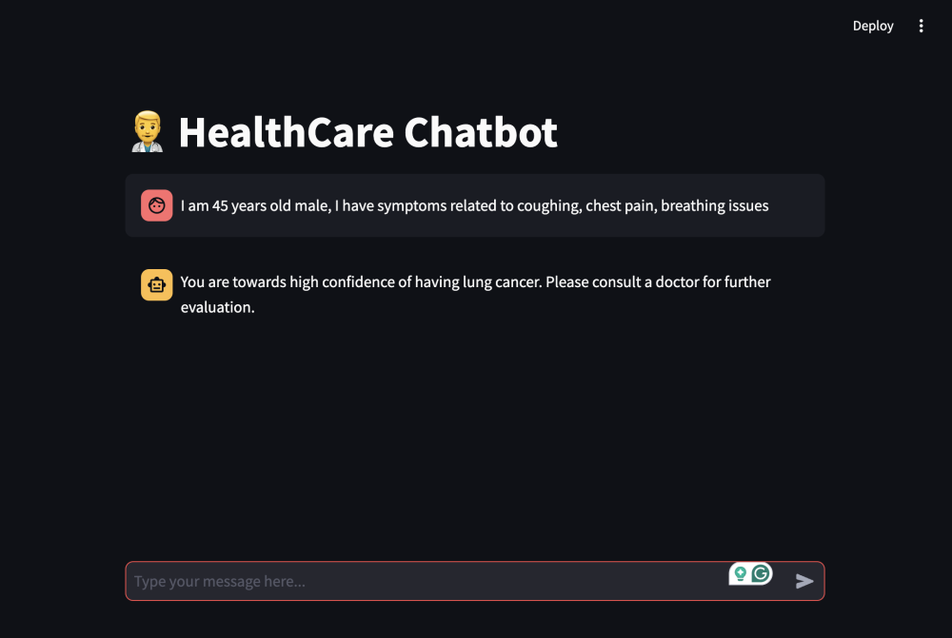

Slide 10

System Architecture on Oracle Cloud
User → Frontend (Streamlit) → API (FastAPI) → RAG Model → Knowledge Retrieval → Response to User
This architecture enables efficient processing and accurate responses by integrating advanced AI with a robust backend.

Slide 11
Code Flow
Here is the process flow with series added to each point:
1. Load Document Data: Load the survey lung cancer CSV file.
https://www.kaggle.com/datasets/mysarahmadbhat/lung-cancer
2. Preprocess Document Data:
- 2.1 Encode categorical variables.
- 2.2 Fill missing data.
3. Train Decision Tree Classifier:
- 3.1 Predict lung cancer (LUNG_CANCER).
4. Convert Rows to Text: Convert rows of data into natural language descriptions.
5. Send Document Text to Nugen API for Embeddings(nugen-flash-embed):
- 5.1 Use the `get_nugen_embeddings` function to get embeddings.
6. Store Embeddings: Store the embeddings in a Pickle file.
7. User Query Input:
- 7.1 The user inputs a query (e.g., "symptoms of lung cancer").
8. Convert Query to Embedding using Nugen: Convert the user query into an embedding using Nugen API.
9. Compute Cosine Similarity (can use RandomForestClassifier,SVM,KNN, BERT) with Pre-stored Embeddings: Compare the query's embedding with pre-stored document embeddings using cosine similarity.
10. Retrieve & Rank Top-k Most Relevant Documents: Retrieve and rank the most relevant documents based on similarity( 70 > - High, <70 is Low).
11. Chatbot Stream Lit UI responds with if User has high/low changes of lung cancer.

Slide 12

Future Enhancements
Model Improvement and Experimentation
Data Expansion and Enrichment
Expanded Knowledge Base: Incorporate more comprehensive cancer-related data.
Natural Language Processing (NLP) Enhancements
Multilingual Support: Enable chatbot responses in multiple languages.
Personalised Real-Time Predictions/Recommendation and Interactive Systems
Integration with Electronic Health Records
Voice Interaction Capabilities: Adding voice-based interaction for enhanced accessibility.

Slide 13
Conclusion
CancerCare AI aims to revolutionize cancer care by offering accessible, accurate, and empathetic support to patients and caregivers.
Our AI-driven approach bridges the information gap and enhances patient comfort.
Thank you for your attention! We are happy to answer any questions you may have.

Slide 14
Thank You!

